Slide 1


Experiment 16
Paralleled Sources with stuck breaker contact
Dr. Norbert Doerry and Dr. John V. Amy Jr.
http://doerry.org/norbert/MarineElectricalPowerSystems/index.htm
© 2025 by Norbert Doerry and John Amy
This work is licensed via: CC BY 4.0 (https://creativecommons.org/)

Slide 2
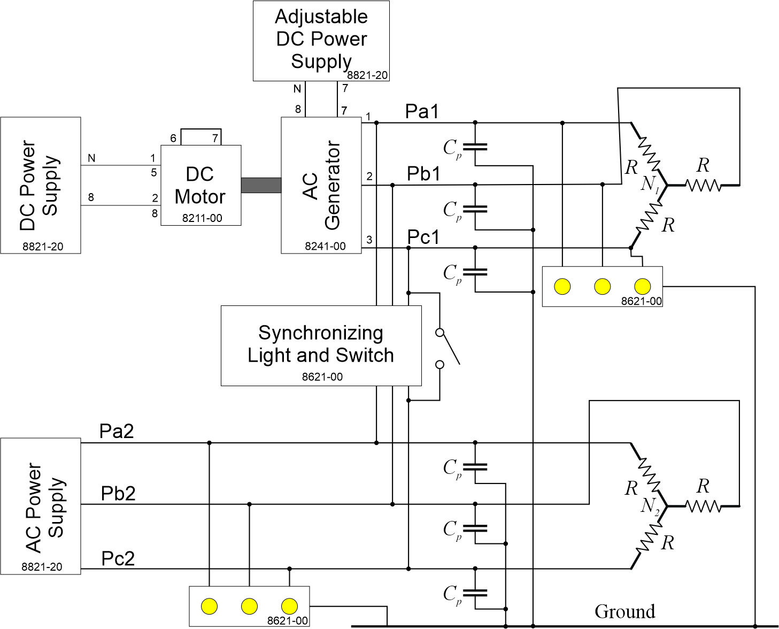
Schematic
C_{p} = 2.2 µF
R = 600 Ω

Slide 3
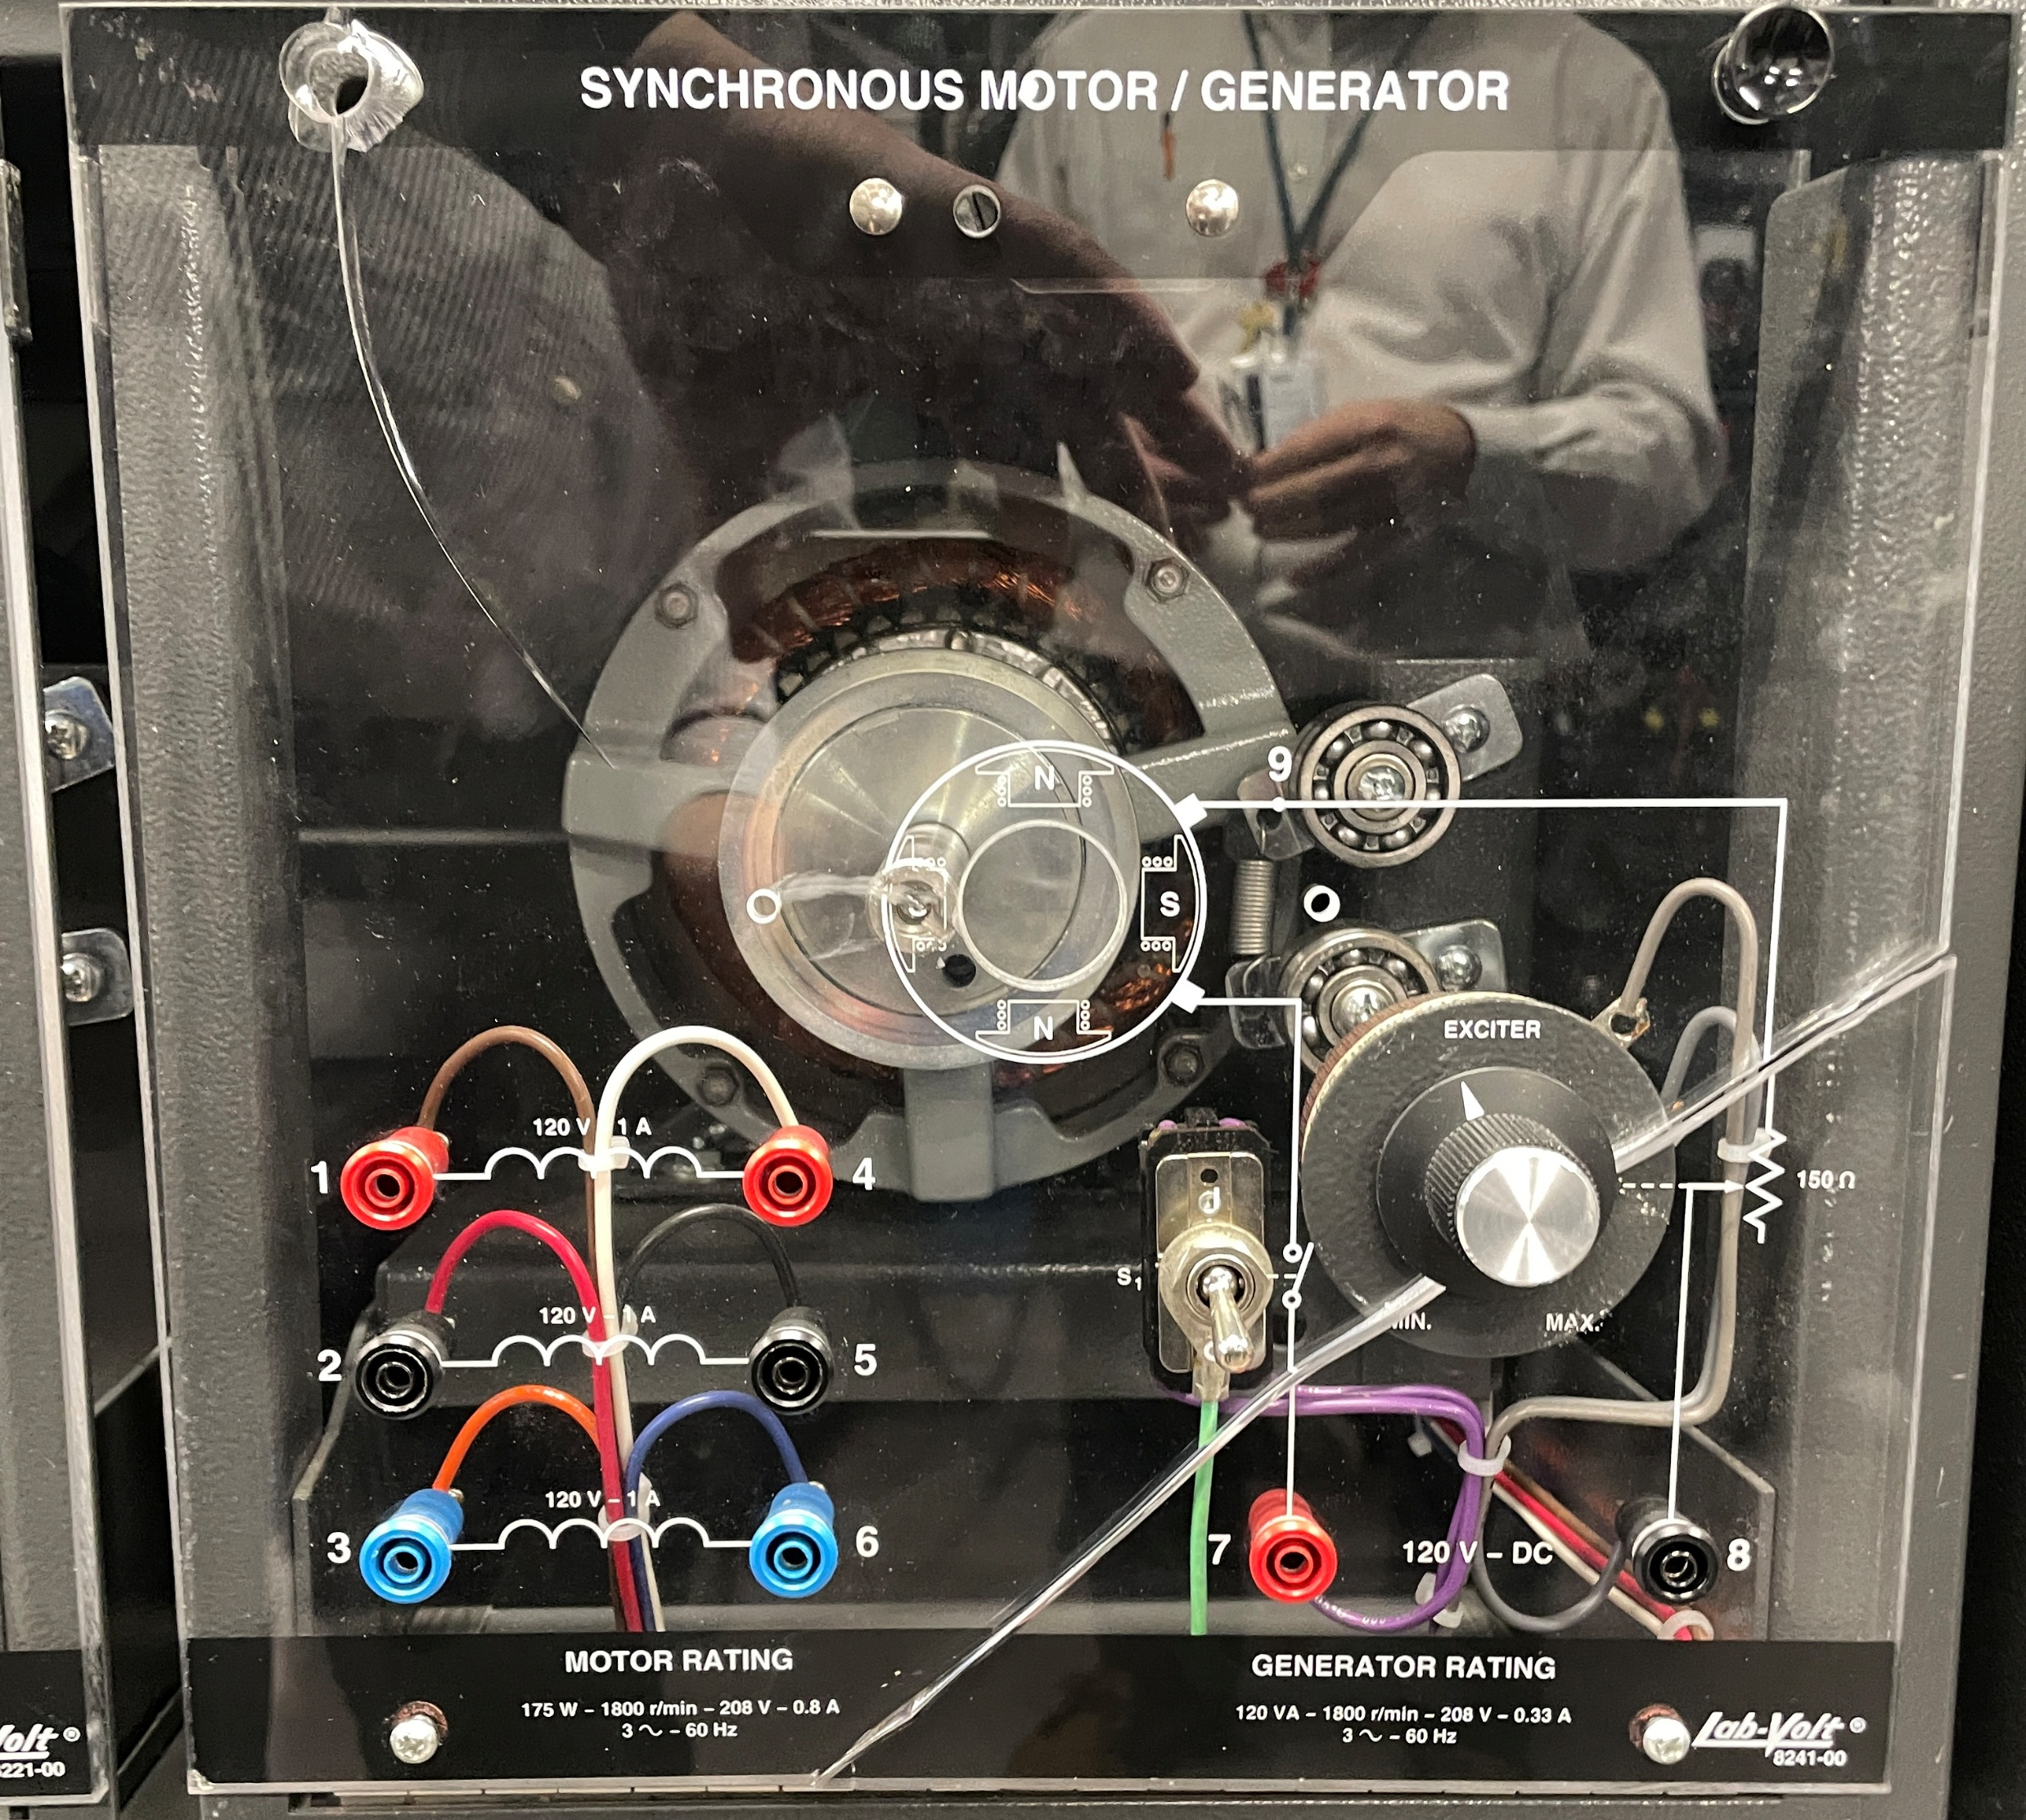
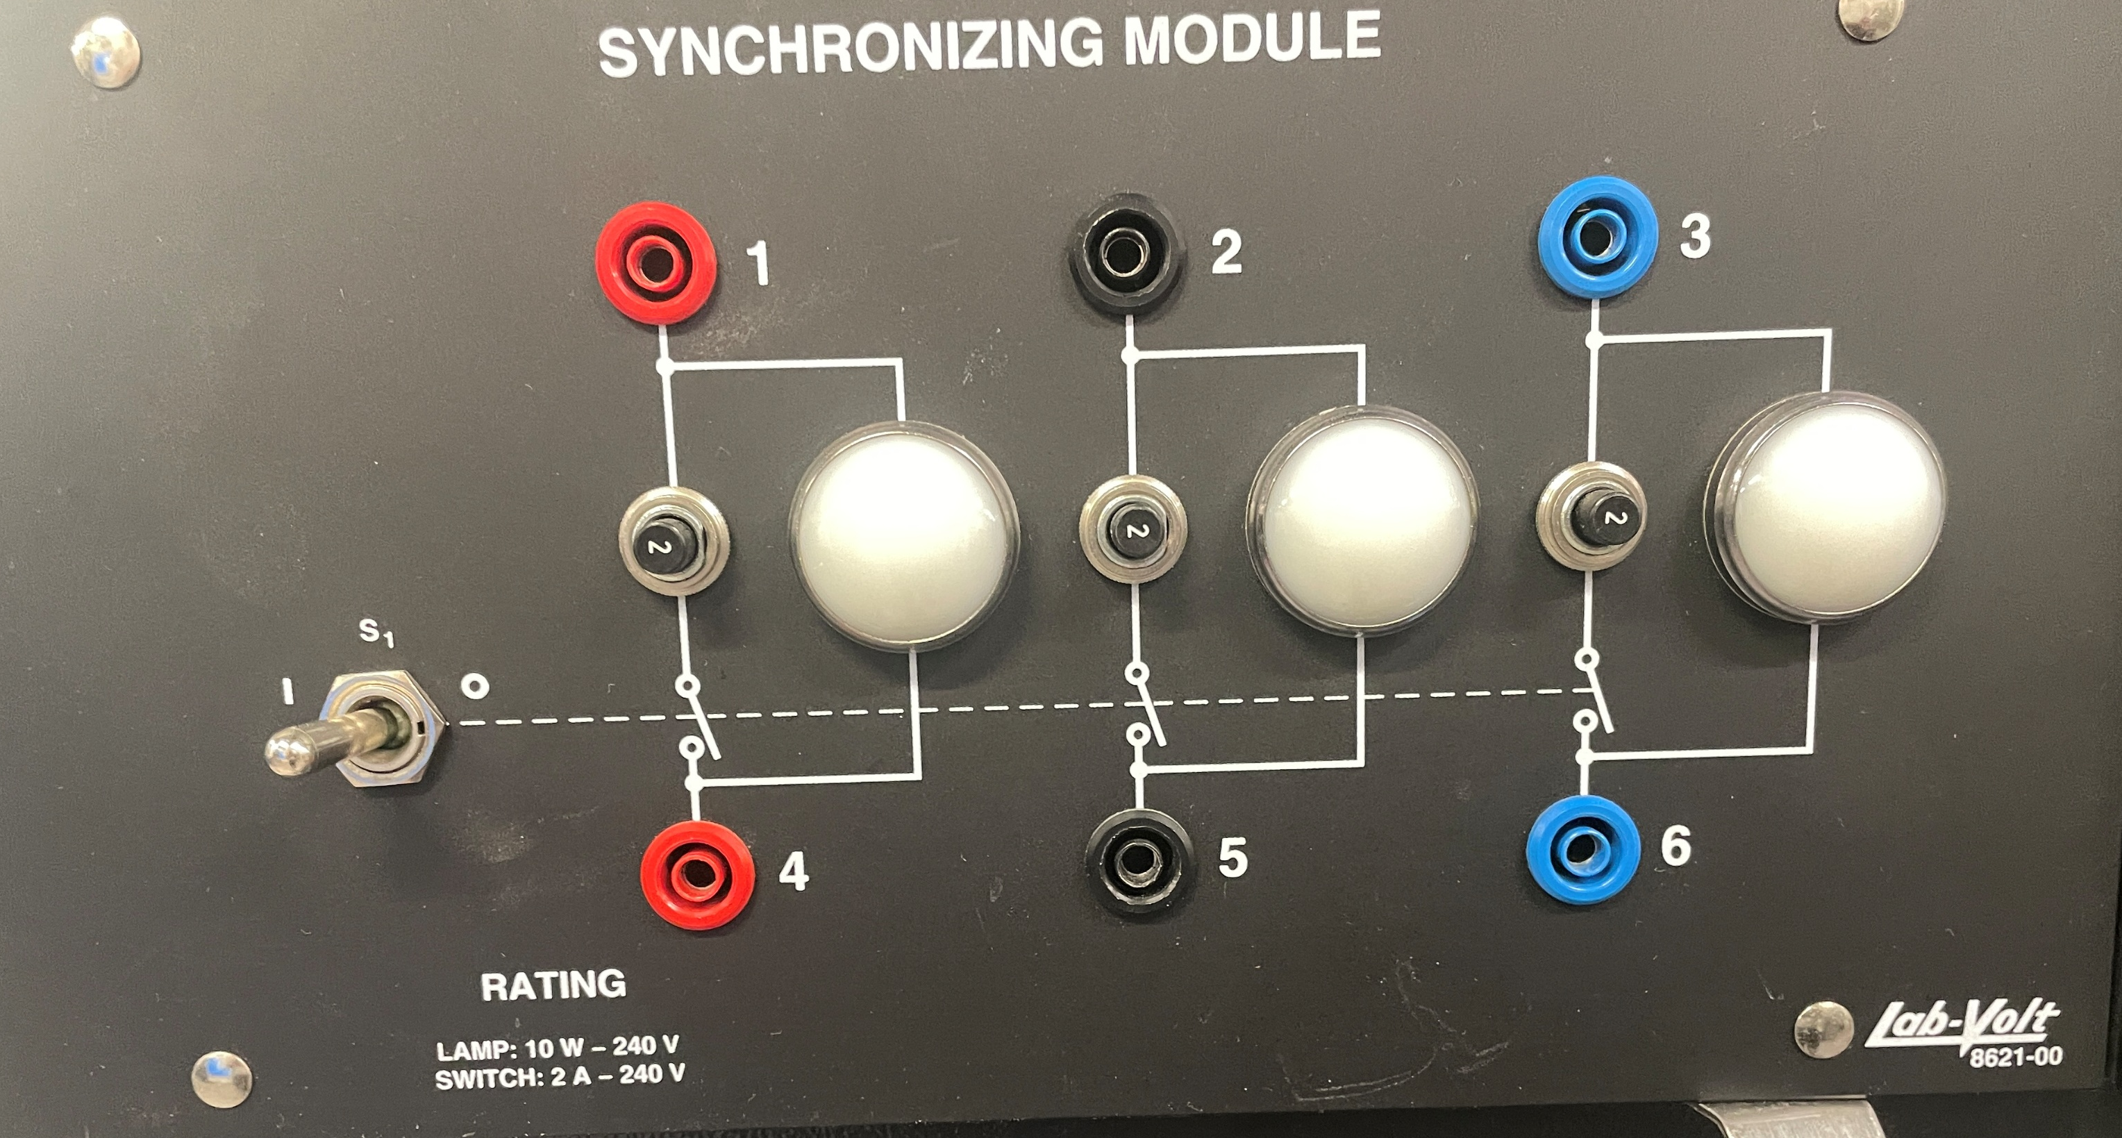
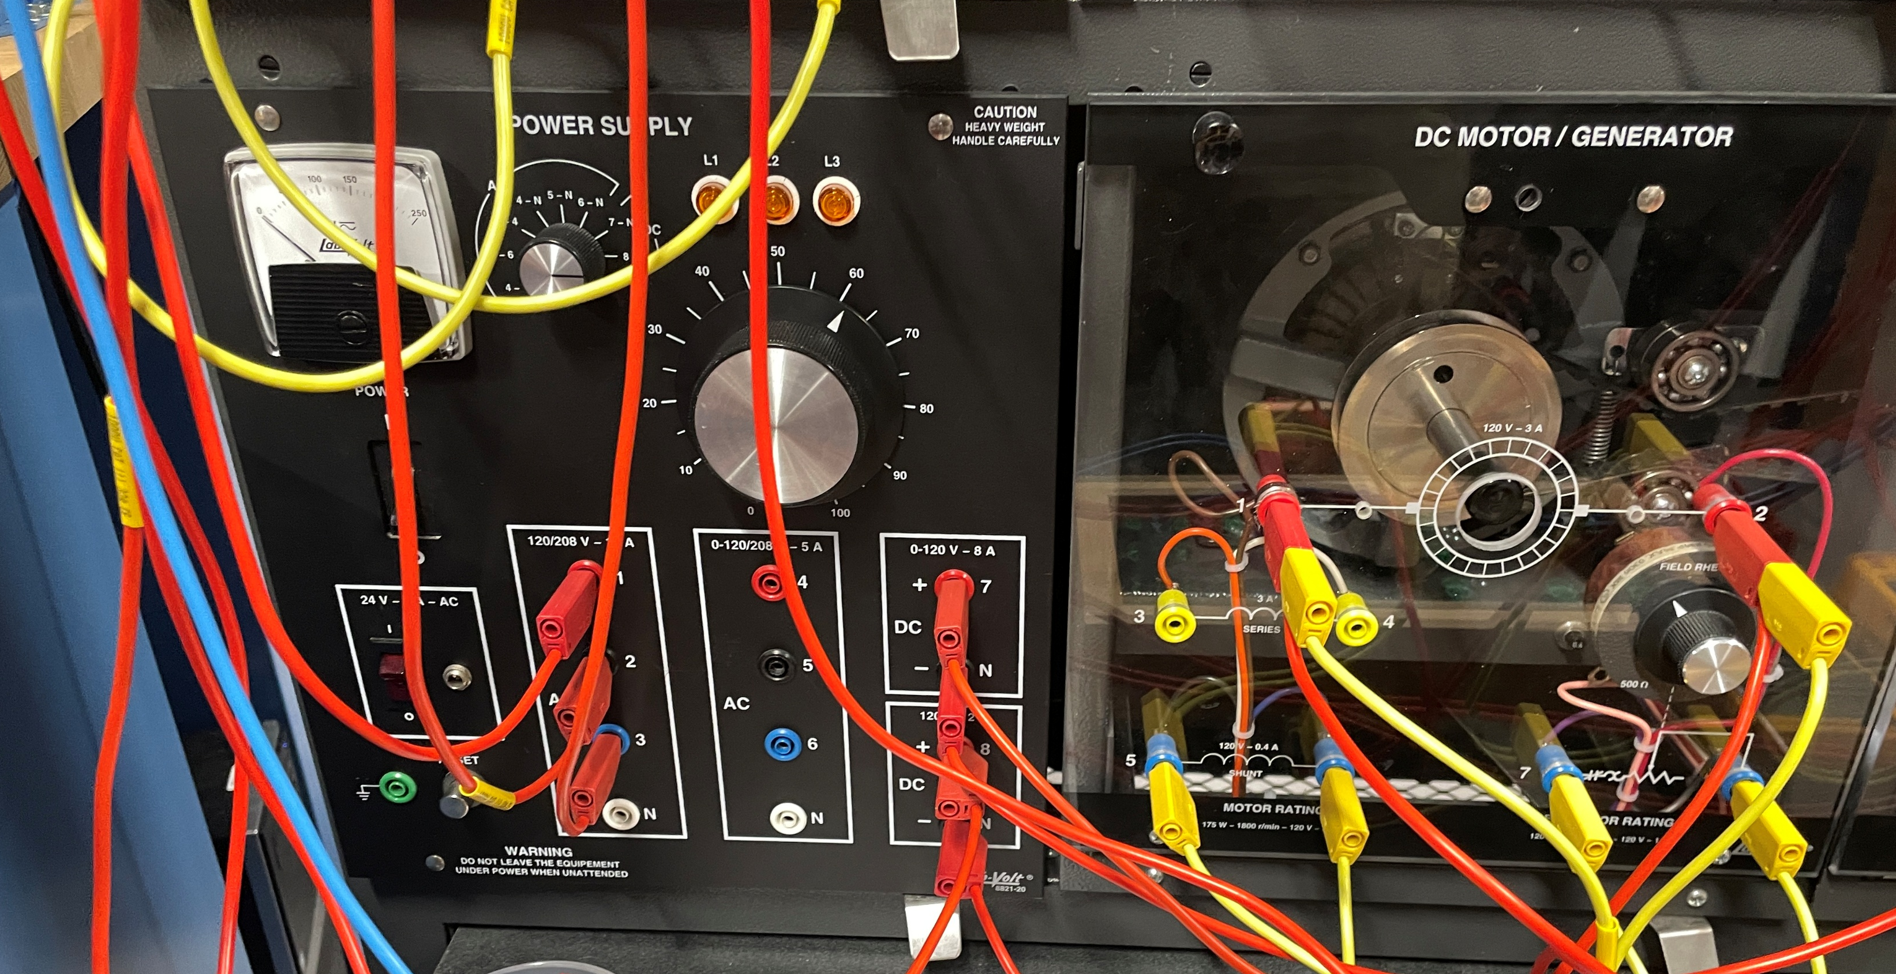
LabVolt Modules
Used both for
Paralleling and
Ground Lamps
Used to Control Voltage
Used to Control Frequency

Slide 4
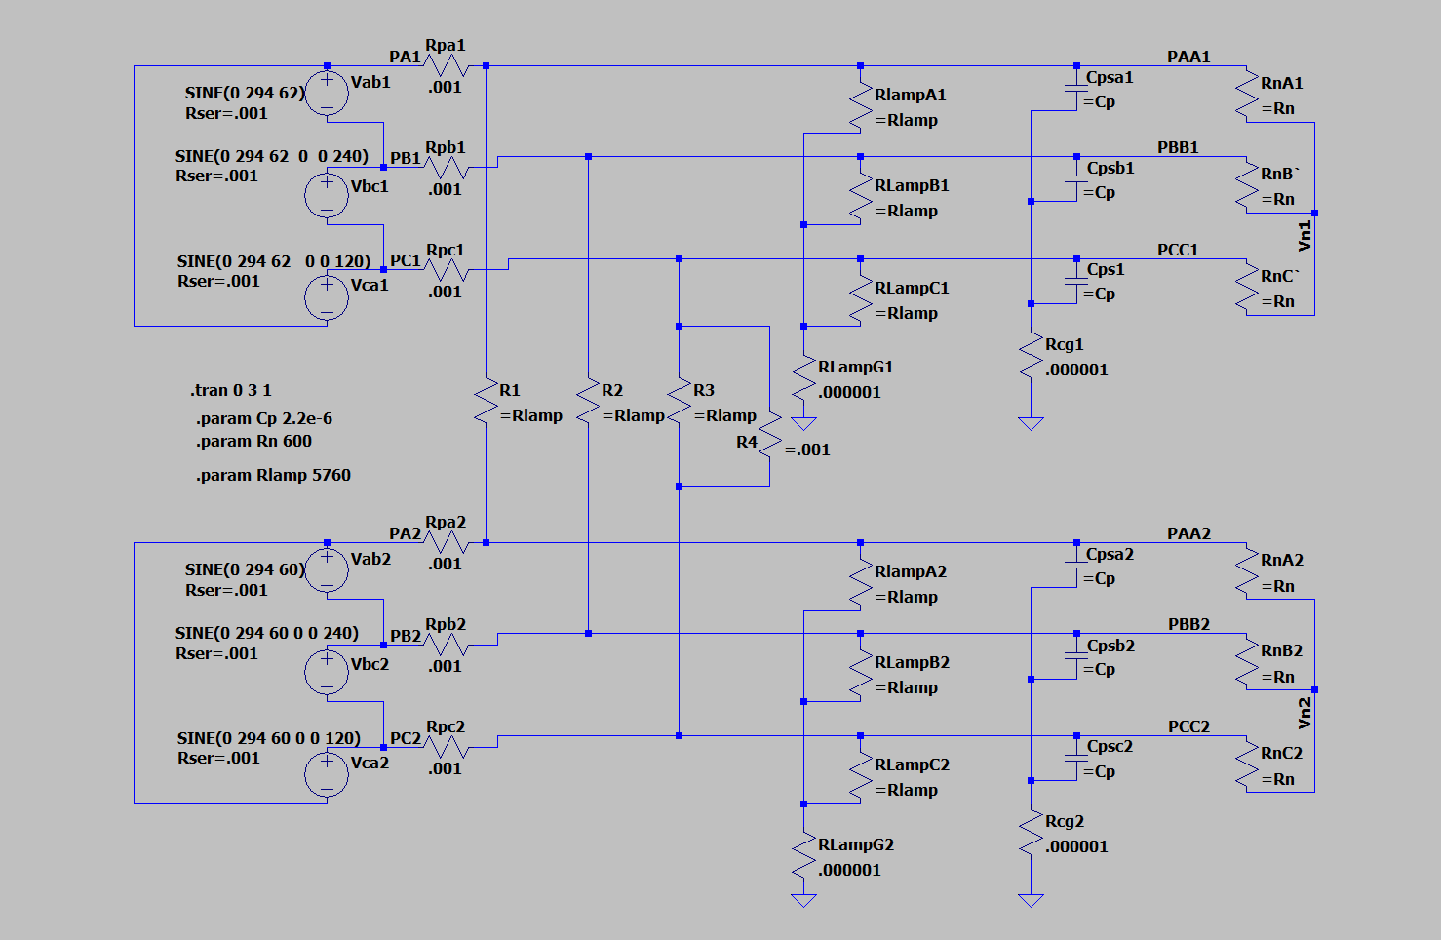
Simulation Model
LTspice
20240727 experiment 1-nl.asc

Slide 5
Procedure to Parallel Generator to Shore Power
Note that ground lamps are equal brightness on both systems
Adjust Voltage on Generator to be slightly greater than shore power
Adjust Frequency on Generator to be slightly greater than shore power
  Goal is for the Generator to take some load when the systems are paralleled
  Avoid reverse powering the motor generator
When synchronization lamps are off, close the paralleling switch
Note that ground lamps are equal brightness.

Slide 6
Stuck Breaker Contact Procedure
With systems paralleled, jumper across one phase
Open paralleling switch.
Adjust frequency of generator to be slightly greater than shore power
Note synchronization lamps
Note ground lamps

Slide 7
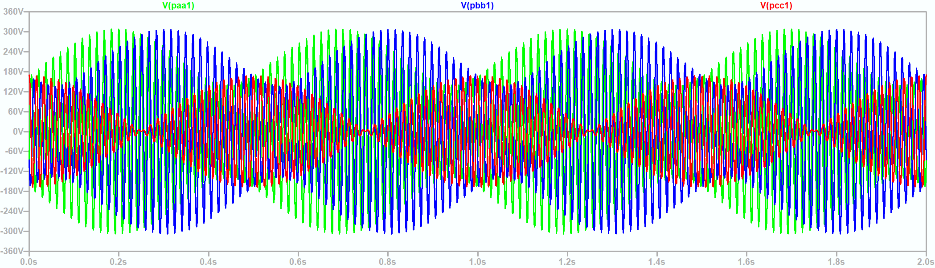
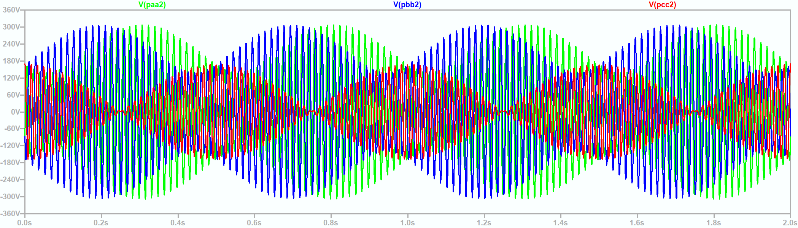
Line to Ground Voltages with stuck contact

Slide 8
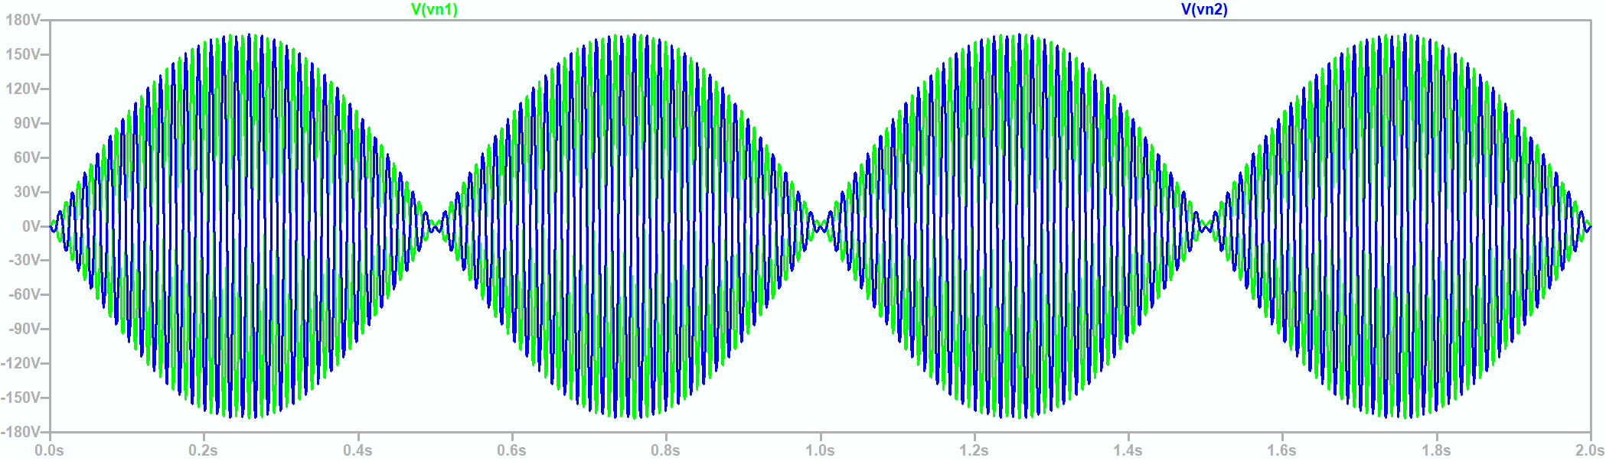
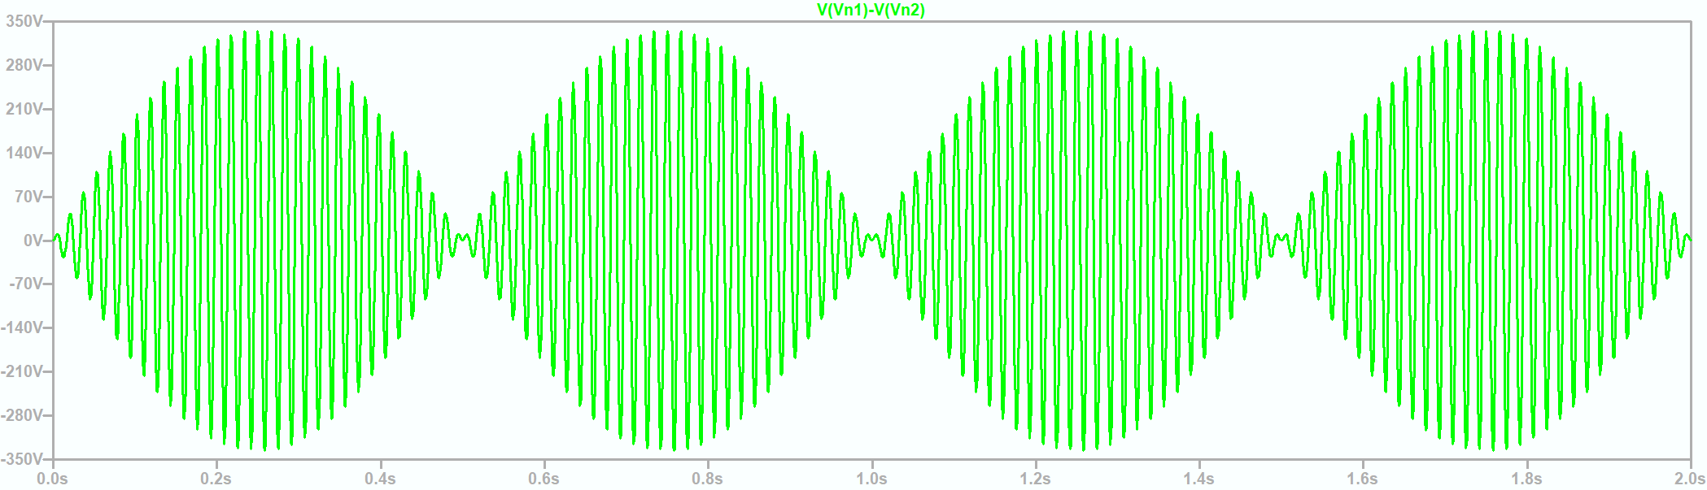
Neutral to Ground Voltages

Slide 9
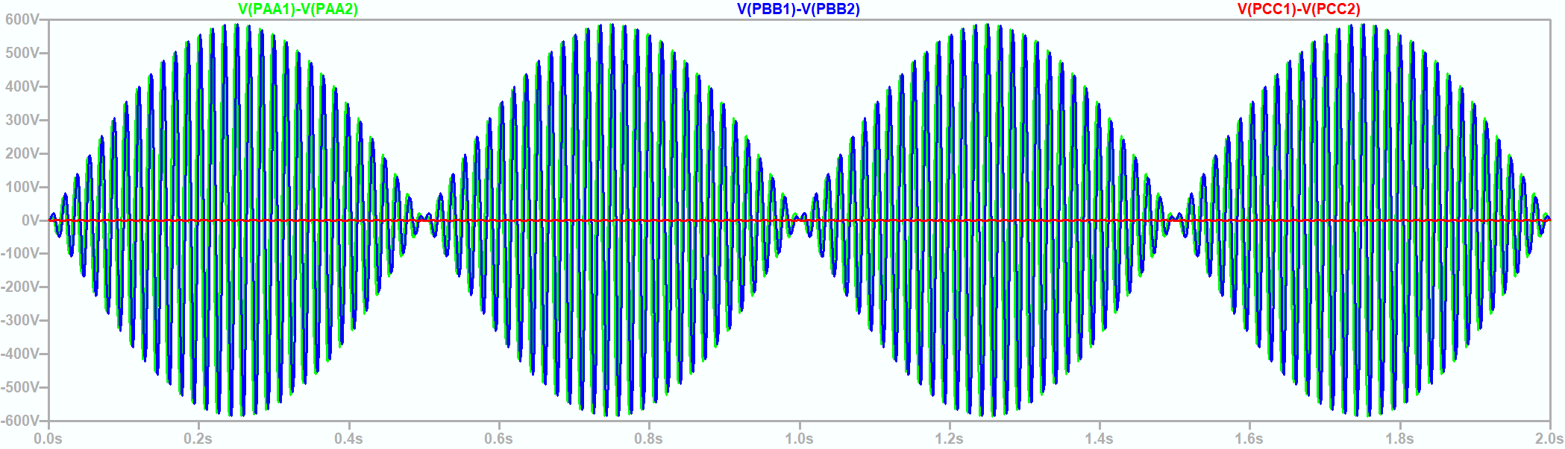
Voltages between system phases

Slide 10
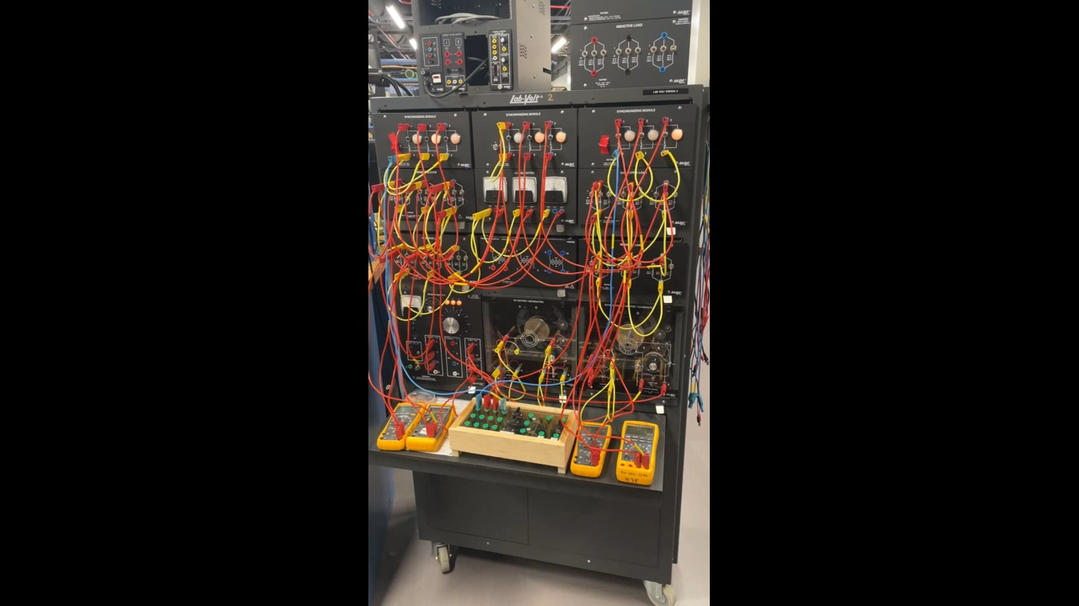
Wrap Up

